Slide 1
Cylinder Battery Technical Document
2022.05.05
Prepared by: Battery Team

Slide 2
History of changes
Algorithm Upgrade (v0.5.3)
No | Details | Date | Prepared | Status
1 | Auto threshold enhance contrast | 31/03/22 | Ky | Implemented
2 | Improve Pole Leaning & Pole Length refinement | 25/04/22 | Giang | Implemented

Slide 3

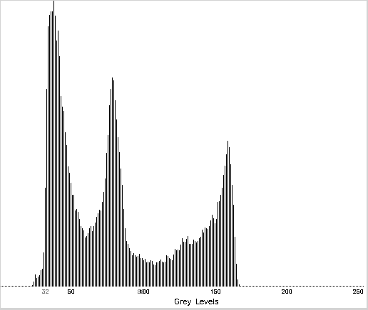
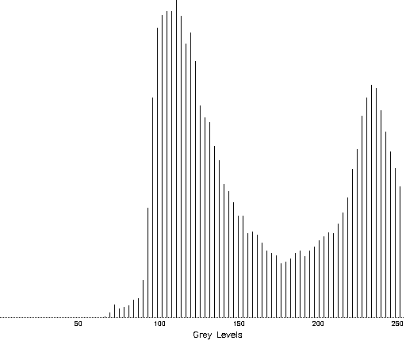
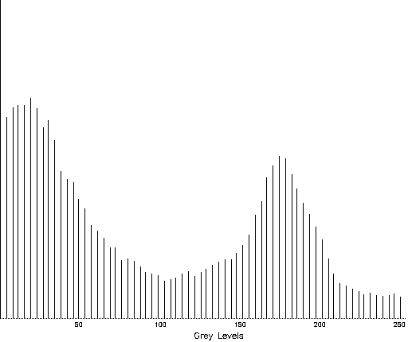

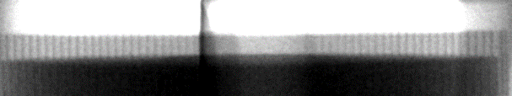

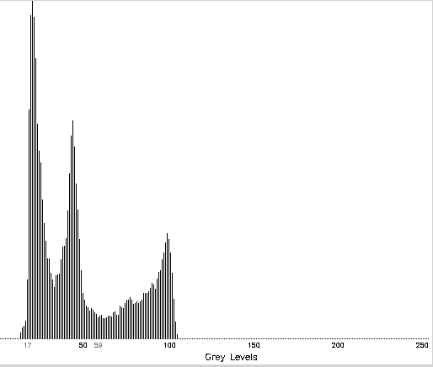
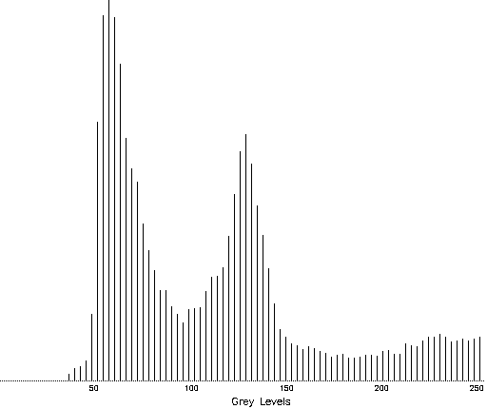
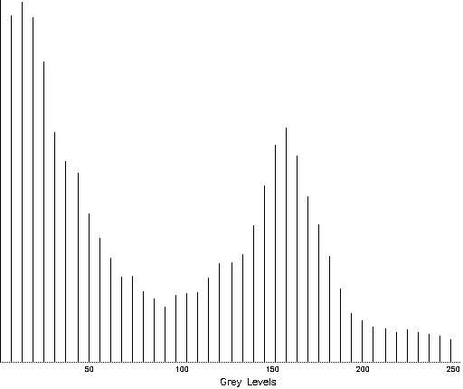
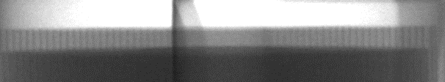
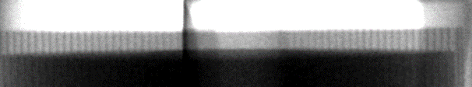
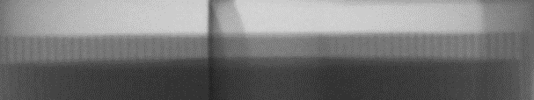
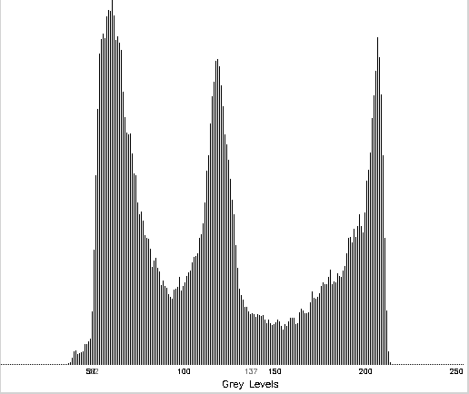
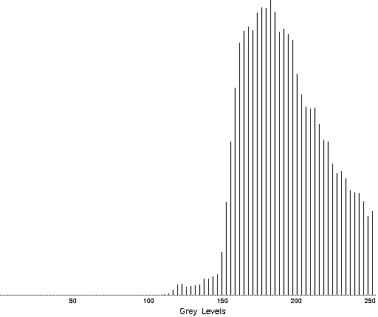
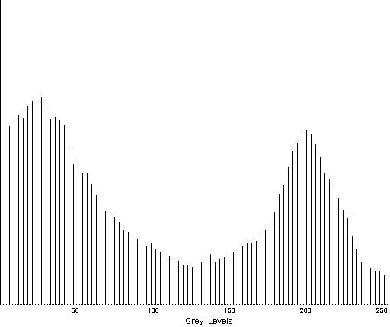


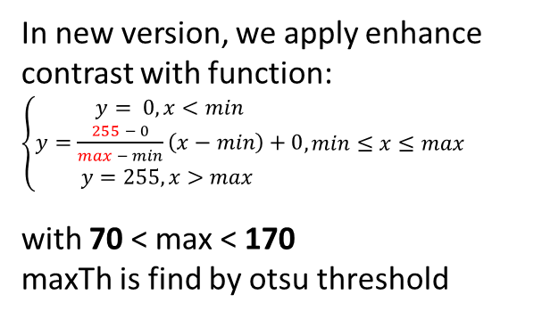
1. Auto threshold enhance contrast
In new version, we apply enhance contrast with function:
$\left\{\begin{aligned}y= 0, x<min \\ y=\frac{255 − 0}{max − min}\left(x−min\right)+0 \\ y=255, x>max \end{aligned}, min≤x≤max\right.$
with 70 < max < 170
maxTh is find by otsu threshold
we apply enhance contrast with function y=3x => we can not find cathode line when gamma change
maxTh(max,255)
minTh(min,0)
Input | Histogram input | His y=3x | y=3x | His auto | auto
R1
min=32
max=99
R2
R2
R1
Original(Gamma = 10)
min=17
max=59
Gamma = 5
min=52
max=137
Gamma = 17
2022-03-28_092325_H03_423128_XSCAN-9200_LOWER_YG_1_NG.tif

Slide 4
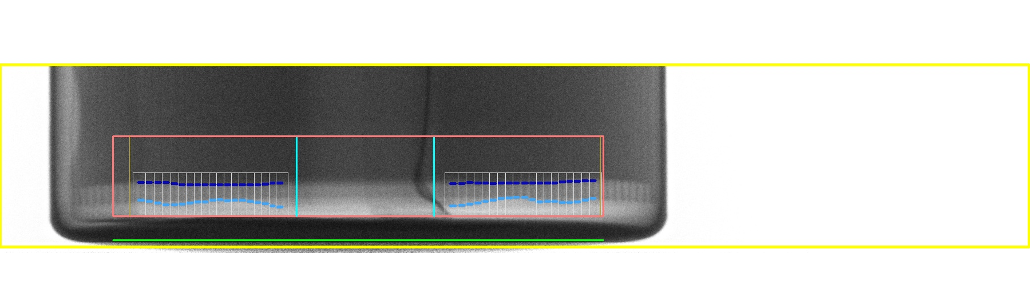
2. Pole Leaning
Pole Leaning Issue
Center of battery case
Pole Leaning detected position
d1=d2
Current Leaning ROI is the region between the two border padding line. So when user setting the border padding to big (dash line) to remove some boundary poles, there are no leaning information. So the algorithm worked incorrectly.
It also caused wrong center estimation (Green line). Neglect center region
Offset from the border padding line (pink line) by the distance d.
d1
d2
Neglect Center region
Border padding
Wrong Leaning Position

Slide 5
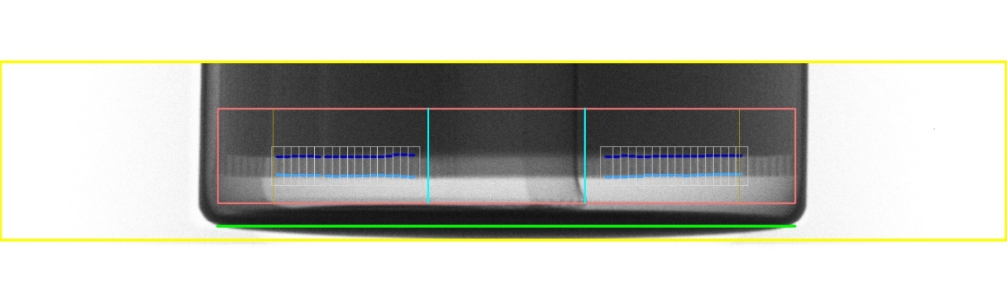
2. Pole Leaning
2. Pole Leaning Improvement
Pole Leaning detected position
Center of battery case
Update:
Pole Leaning ROI is the region between two red lines. Red line is offset from the border of the battery to 0.012* battery width.
After finding the Pole Leaning position. Adjust the affective range (battery center/neglect region) to the new value.
Border padding to remove unwanted pole will be calculated from the pole leaning detected positions (orange lines) then remove the poles in the setting range.
d1=d2
d1
d2
Affective range
Neglect Center region
Border padding

Slide 6
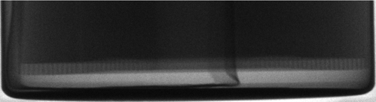
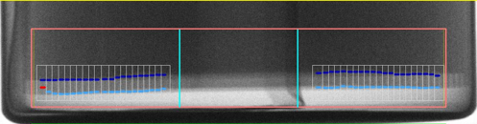
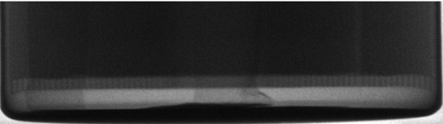
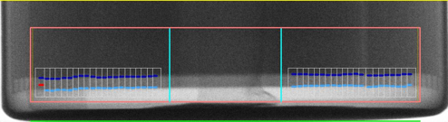
8. iBC-232 상/하부 과검(1)
iBC-232 TOP/BOT overdetection
현상 | Pole 검사
결과
현상 Hiện tượng | iBC-232 최외각 검사 미흡으로 과검 빈도 높음 Tần suất over-detect cao do kiểm tra không chính xác vùng ngoài cùng
결과 Kết quả | 과검율 0.05% 목표 → 현재 과검률 약 0.8% Mục tiêu overdection là 0.05%-> Tỉ lệ hiện tại tầm 0.8%

Slide 7
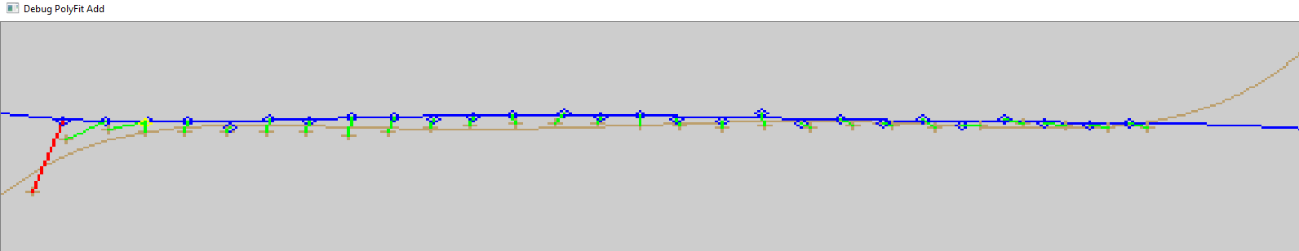
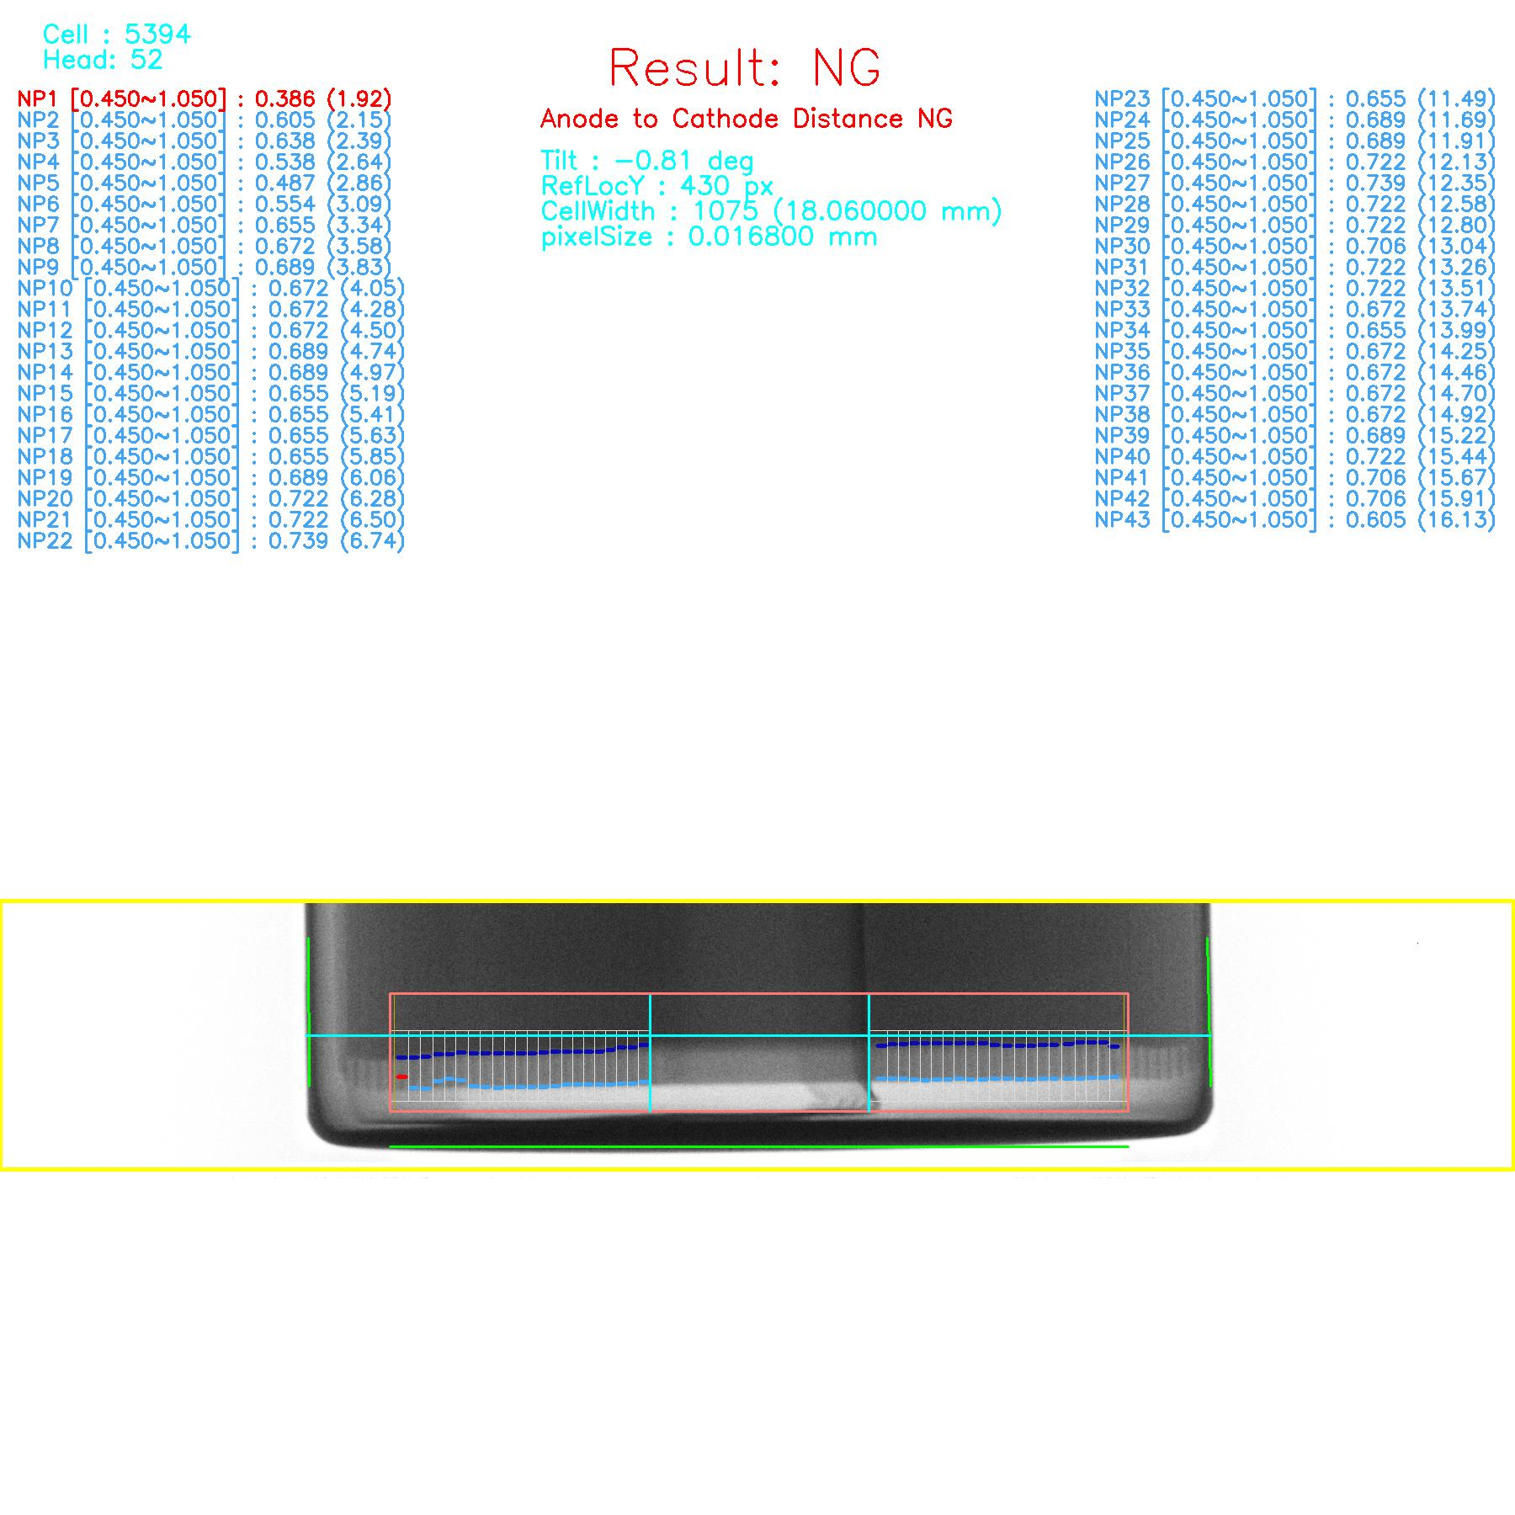
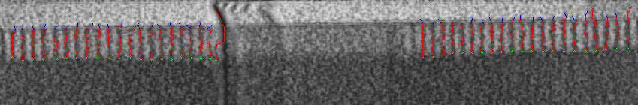
2. Pole Length Refinement
Issue.
- Matching Poles
- Refine pole by the position.
Wrong corresponds Pole
Refine by position Issue

Slide 8
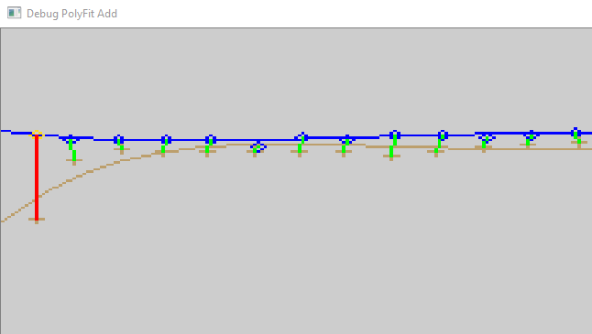
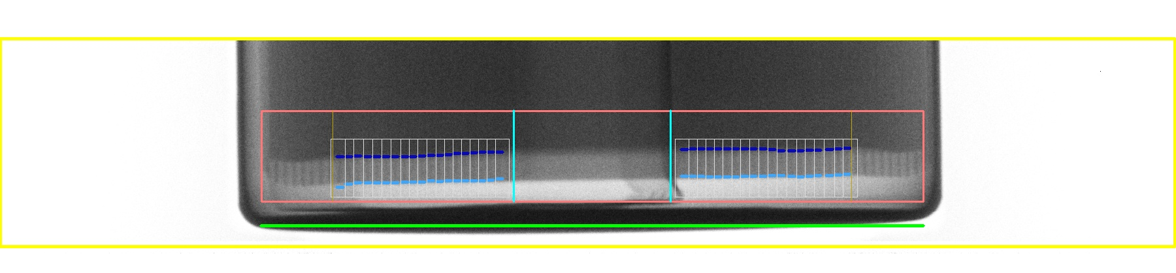
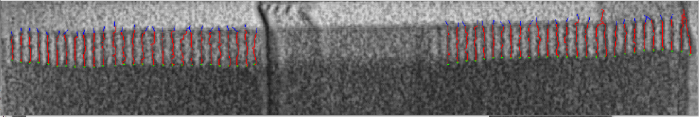
2. Pole Length Refinement
Improvement.
Update finding the corresponding poles.
Only refine the pole that reliable. And update by the length instead of the position.
corresponding poles
Refine by pole length

Slide 9
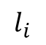
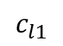
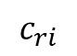
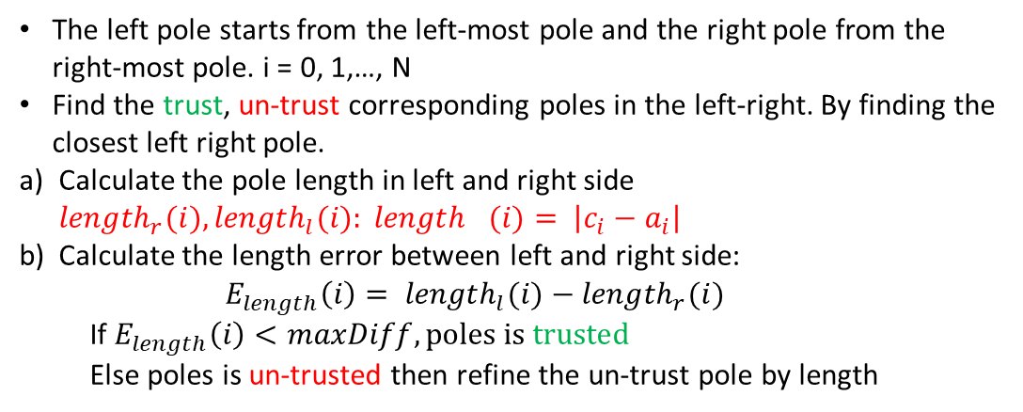
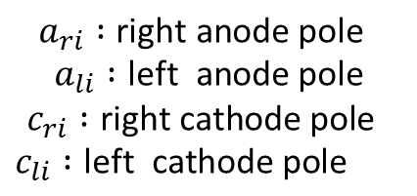
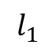
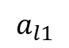
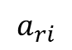
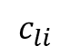
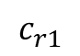
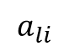
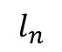
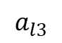
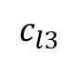
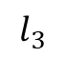
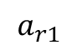
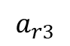
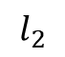
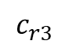
2. Pole Length Refinement
Improvement.
$$a_{l1}$$
$$a_{l3}$$
$$a_{li}$$
$$a_{ri}$$
$$a_{r3}$$
$$a_{r1}$$
$$a_{ri} :\text{right} \text{anode} \text{pole}$$
$$a_{li} :\text{left} \text{anode} \text{pole}$$
$$c_{ri} :\text{right} \text{cathode} \text{pole}$$
$$c_{li} :\text{left} \text{cathode} \text{pole}$$
Anode
$$l_{1}$$
$$l_{2}$$
$$l_{3}$$
$$l_{i}$$
$$l_{n}$$
Cathode
$$c_{ri}$$
$$c_{r3}$$
$$c_{r1}$$
$$c_{l1}$$
$$c_{l3}$$
$$c_{li}$$
The left pole starts from the left-most pole and the right pole from the right-most pole. i = 0, 1,…, N
Find the trust, un-trust corresponding poles in the left-right. By finding the closest left right pole.
Calculate the pole length in left and right side ${length}_{r}(i),{length}_{l}(i): {length}_{}(i)= \left|c_{i}−a_{i}\right|$
Calculate the length error between left and right side:
$$E_{length}\left(i\right)= {length}_{l}(i)−{length}_{r}(i)$$
If $E_{length}\left(i\right)<maxDiff, poles is trusted$
Else poles is un-trusted then refine the un-trust pole by length
+ : left anode pole
O : right anode pole
correspond trust, un-trust poles

Slide 10
History of changes
Algorithm Upgrade (v0.5.2)
No | Details | Date | Prepared | Status
1 | Tolerance Shift | 31/03/22 | Ky | Implemented

Slide 11
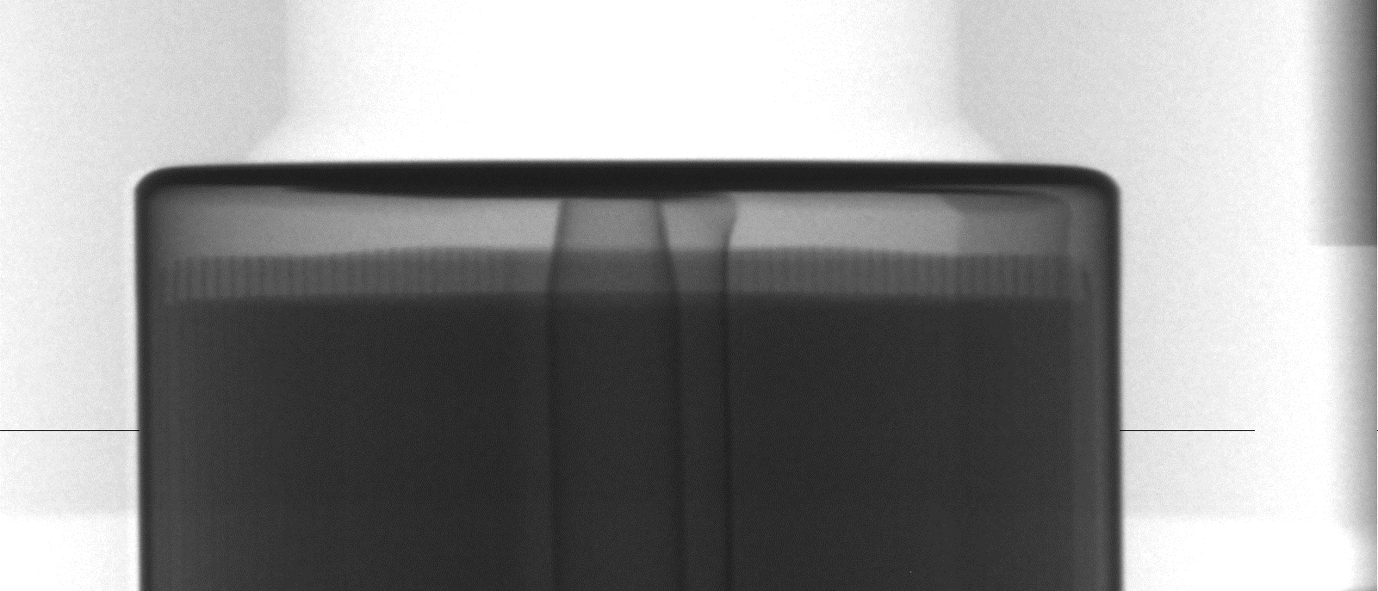
1. Tolerance Shift
Image coordinate
Battery Detected ROI Y
Battery coordinate
(BatROI)
J-Roll Top position (JRpos) found in the battery coordinate
Pole Region in Image coordinate
Current pole region ROI position : poleROI.y = BatROI + JRpos.y + toleranceShift
So when user change the toleranceShift to the big value the inspection pole region top line will cutout the poles. It due to the wrong detection
The correct equation should be: poleROI.y = BatROI + JRpos.y
The drawing in the result image is not correct to the toleranceShift value

Slide 12
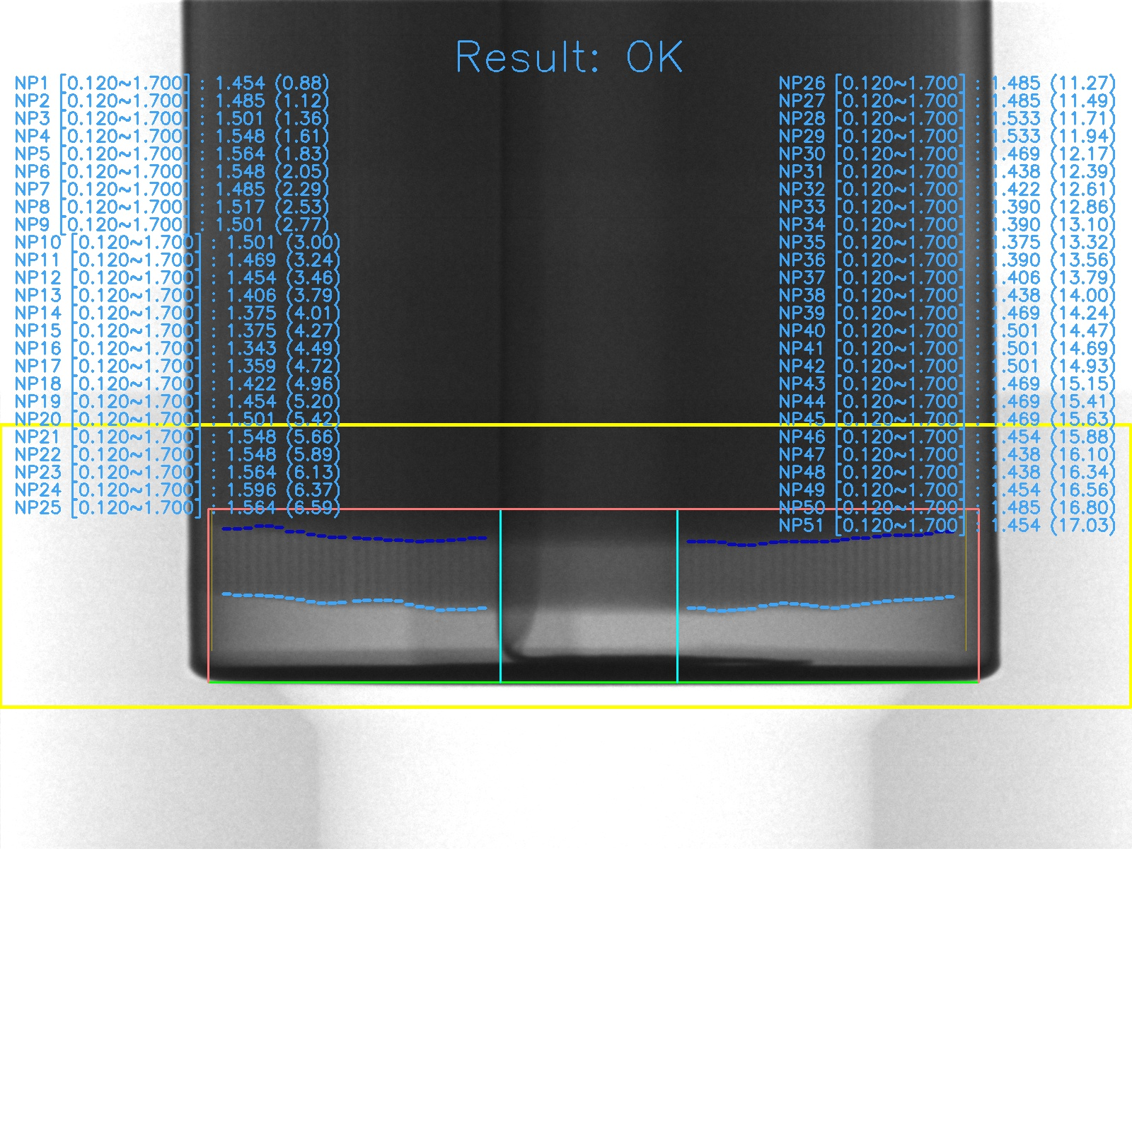
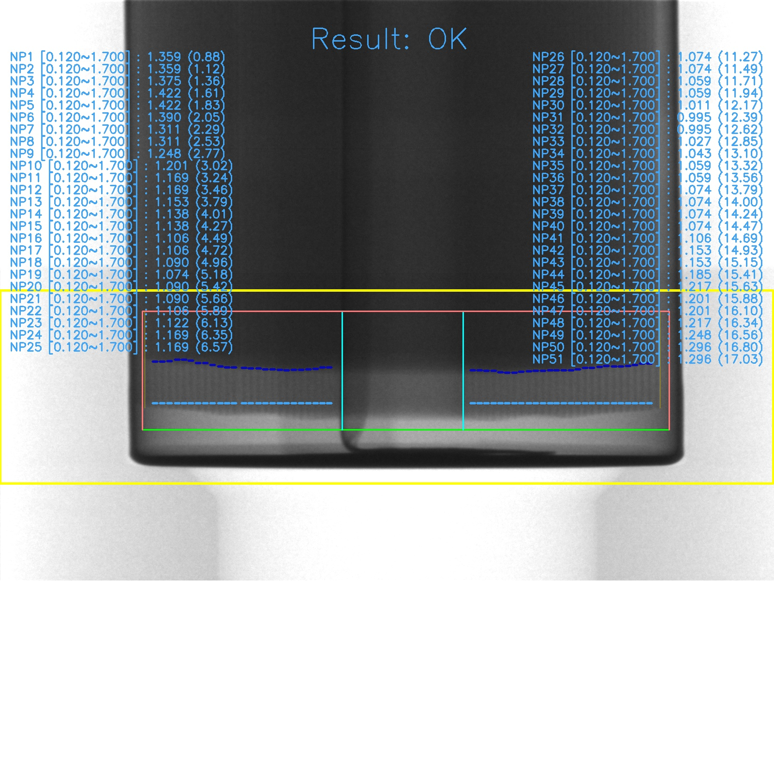


1. Tolerance Shift
toleranceShift = 4
Pole Region is change
toleranceShift = 80
v0.5.1
Case line
Case line
v0.5.2
Pole Region is same

Slide 13
History of changes
Algorithm Upgrade (v0.5.1)
No | Details | Date | Prepared | Status
1 | Cathode line refinement local average | 23/03/22 | Phu | Implemented
2 | Find Cathode Line Position by using CDF | 16/03/22 | Tan | Implemented

Slide 14
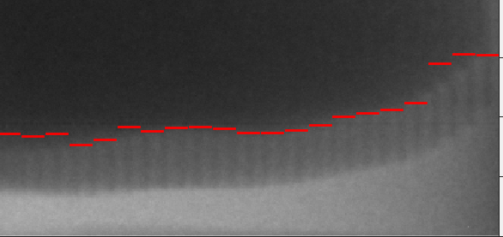
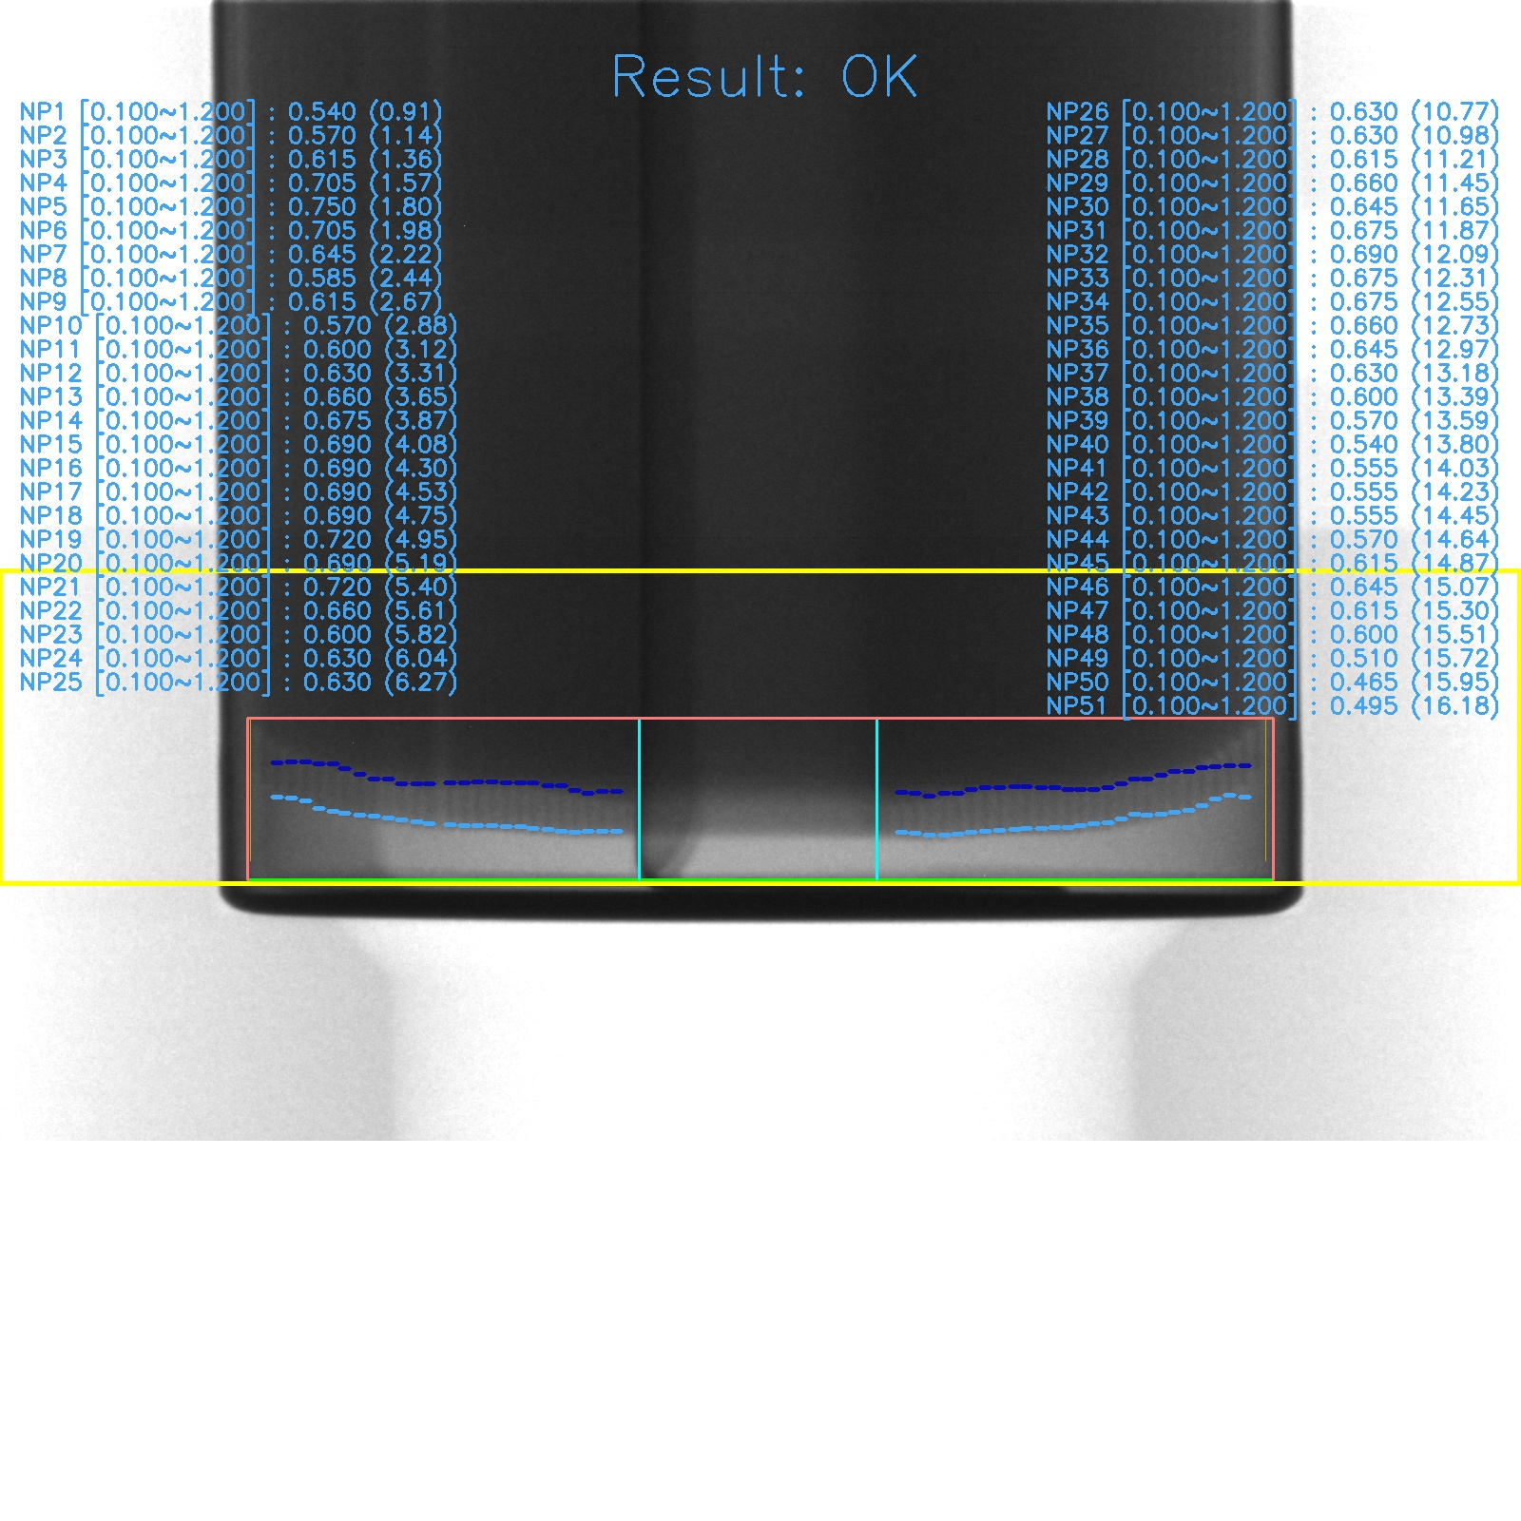
1. Cathode line refinement local average
Cathode line detection result
Cathode line refinement result
We found that even the cathode line detection result is OK, but then, the cathode line refinement step make it become not correct
Algorithm comparison:
 | Old algorithm | New algorithm
Description | Calculate global average of all cathode line position Then using standard deviation to make the limitations of cathode line position If any cathode line stay outside the limitations, we neglects it | Replace the global average to local average, size of local window = 11.

Slide 15

1. Algorithm comparison: Cathode line refinement local average
Global average
Cathode line
limitations
Local average
Window size = 11
Cathode line
limitations

Slide 16

1. Result: Cathode line refinement local average
133217_XSCAN-9200_LOWER_YG_1_0_9492_H21_NG.tif
Old Algorithm
New Algorithm

Slide 17




2. Find Cathode Line Position (Previous version)
For finding Cathode Line Position:
Identify jumping windows with Cathode Line Window Size parameter
From each jumping window, apply horizontal projection
Applying find peak prominence algorithm, we found the Y position of cathode line based on Cathode line threshold in each specific region (Inner, Middle, Outer)
Finally, we merged all results from jumping windows to generate the final cathode line
Outer
Middle
Inner
Merge all results

Slide 18




2. Find Cathode Line Position by using CDF(New version)
2
1
For finding Cathode Line Position:
From border padding parameter and jrTop point => we have Image ROI
From image (2), we apply global enhanced contrast to get image (3)
Identify jumping windows with Cathode Line Window Size parameter
For each window, we calculate the horizontal projection (red line) and CDF normalization (yellow line). In two last turning points, we identify the peak as the cathode position.
Finally, we merged all results from jumping windows to generate the final cathode line
3
5
4

Slide 19



2. Find Cathode Line Position by using CDF(New version)
CDF
Identify jumping windows with Cathode Line Window Size parameter
For each window, we calculate the horizontal projection (red line) and CDF normalization (yellow line). In two last turning points, we identify the peak as the cathode position.
First find last turning point(cdf_bottom):
$\left\{\begin{aligned}diffLeft>threshold and \\ diffRight<threshold\end{aligned}\right.$
Find last second turning point(cdf_up):
$\left\{\begin{aligned}diffLeft<threshold and \\ diffRight>threshold\end{aligned}\right.$
diffLeft = cdf[i - 2] – cdf[i] : Left data (cdf) slope trend
diffRight= cdf[i] – cdf[i+2] : Right data (cdf) slope trend
threshold = 0.06
CDF normalization
cdf(i - 2)
cdf(i+2)
CDF Turning points Up(cdf_up)
1
0
CDF Turning points Bottom(cdf_bottom)
cdf(i)

Slide 20





2. Result: Find Cathode Line Position by using CDF(New version)
104825_XSCAN-9200_LOWER_YG_1_0_4275_H33_NG
Old
New
In old version, when we apply fix threshold, in this case, we can not find any peak satisfy threshold => we can not find the peak
In new version, we apply enhance contrast with function y=3x and apply CDF function, then we can find peak without using threshold.

Slide 21





2. Result: Find Cathode Line Position by using CDF(New version)
093144_XSCAN-9200_LOWER_YG_1_0_1413_H02_NG
Old
New
In old version, when we apply fix threshold, in this case, we can not find correct peak
In current version, when apply enhance contrast and CDF, we can identify correctly peak

Slide 22





2. Result: Find Cathode Line Position by using CDF(New version)
093603_XSCAN-9200_LOWER_YG_1_0_1874_H20_NG
Old
New
In old version, when we apply fix threshold, in this case, we can not find any peak satisfy threshold => we can not find the peak
In new version, we apply enhance contrast with function y=3x and apply CDF function, then we can find peak without using threshold.

Slide 23
History of changes
Algorithm Upgrade (v0.5.0)
No | Details | Date | Prepared | Status
1 | Recheck Line Tracing Disconnection Pole | 24/01/22 | Tan | Implemented

Slide 24




1. Recheck Line Tracing Disconnection Pole
2022. 01. 24
When applying Line Tracing, our algorithm will detect the ending point when If condition(lowest intensity > anodeThreshold(*)) is met 5 consecutive times, then break
In picture below, when pole is disconnected, line tracing algorithm can not identify correctly the ending point

Slide 25

1. Recheck Line Tracing Disconnection Pole
Step 1: Find the average of normal height
Step 2: Take all the candidate poles which have height lower than normal height /1.5
Step 3: In each disconnected pole, applying re-check (line tracing) the anode position from disconnected point
Step 4: Update the anode position for disconnected pole

Slide 26

1. Recheck Line Tracing Disconnection Pole
Step 3 Details:
A: Ending Point of Disconnected Pole
B : Cathode Position
From Point (Xb,Ya-1), we apply average cumulative function with window (1,7)
If any point C satisfy the condition : average intensity <= anodeThreshold in 5 consecutive times -> We consider this point as new starting point
Applying line tracing from C and find D as the correctly anode position
D
C
A
B

Slide 27







1. Result: Recheck Line Tracing Disconnection Pole
Before
After

Slide 28
Flow Chart Algorithm
CImageProcessorCylinderBattery::Inspection
Cylinder Battery
CImageProcessorCylinderLower::Inspection
Upper Case
Lower Case
findBatteryROI
Pre-define Outer Rectangle
Pre-define Outer Rectangle
findBatteryROI
Inspection
Validate the width of Battery
Validate the width of Battery
Inspection
findBeadingInspection
Beading Inspection (Only Upper Case)
Finding J/R position
findTopReferenceLine
findTopReferenceLine
Finding J/R position
Check Center PIN in Lower Part
findingcenterpin
findCathodeLineByPeak
Finding Cathode Line Position
Finding Cathode Line Position
findCathodeLineByPeak
findCathodeXPosition
Finding Cathode X position
Finding Cathode X position
findCathodeXPosition
FindLosingPoleLite
Add missing cathode position
Finding Anode Position
findAnodeYCordUpper
findAnodeYCordUpper
Finding Anode Position
Pole Length Refinement
PoleLengthRefinement
Pole Length Refinement
PoleLengthRefinement

Slide 29


Cylinder Battery UI and Setting Parameters
Upper
Lower

Slide 30



Pre-define Outer Rectangle
① : Select roughly the upper part of the battery (Using Outer Roi X,Y, Width, Height parameters) in Image 1
② : Apply the auto binarization thresholding (Otsu thresholding) for highlighting only the interested battery region
③ : Finding contour of battery region
④ : Find boundary rectangle of the contour (Red Rectangle) in image 2. The boundary width is corresponding battery‘s maximum outer diameter.
Outer Roi (X,Y)
Outer Roi Width
Outer Roi Height
1
2

Slide 31

Validate the width of Battery
Based on three parameters Pixel size ( the converted parameter from mm to pixel), MasterJig Cell size (the optimal width of battery in mm) and Cell Size Tolerance ( the offset percentage of cylinder width), we can estimate acceptable min and max of cylinder width based on formula:
int minRangeWidth = round((BatInsp.masterJigCellSize / BatInsp.pixelSize) * (1.0 - BatInsp.cellSizeTolerence));
int maxRangeWidth = round((BatInsp.masterJigCellSize / BatInsp.pixelSize) * (1.0 + BatInsp.cellSizeTolerence));
If battery width> minRangeWidth or battery width < maxRangeWidth => OK
Else => NG
Battery Width

Slide 32



Beading Inspection (Only Upper Case)
From boundary battery (ROI) we found from Pre-define Beading Rectangle step, we divide this ROI to become two ROI (2.1 and 2.2) based on battery width.
From ROI 2.1, we apply Otsu Threshold and median blur filter then applying vertical projection from left to right.
Using Tuning Pixel parameter, we can find the turning point A (xA,yA) based on the conditions:
if ((bounderContour[i].x - bounderContour[i - 1].x > Tuning Pixels)
&& (bounderContour[i].x - bounderContour[i - 2].x > Tuning Pixels)
&& (bounderContour[i].y < Roi Height))
From point A (xA,yA) to the bottom of contours, we find the point which have the largest X position => It is the P1 (xP1,yP1).
L1 (xL,yL) is the extreme left point of the contour
From A (xA,yA), project perpendicularly up until reach white area => B(xB,yB)
(Battery Width / 2, 0)
O(0, 0)
ROI 2.1
ROI 2.2
Roi 2.1
(0, Beading Height)
B(xB,yB)
L1 (xL, yL)
A (xA,yA)
P1(xP1,yP1)
Vertical projection data

Slide 33

Beading Inspection (Only Upper Case)
x
(D6 / 2, 0)
Apply similar process as we did in ROI 2.1 for ROI 2.2, we also can find P2 (xP2,yP2)
Then we calculate the distance (X) between P1 and P2 based on:
Distance D2 = xP2 – xP1;
From L1 and P1 points, we calculate the X distance between L1 and P1:
Distance D7 = xL – xP1
From B and A1, we calculate the Y distance between B and A1:
Distance D1 = yA1 – yB.
y
O(0, 0)
B(xB,yB)
ROI 2.1
ROI 2.2
D1
L1 (xL, yL)
A1(xA1,yA1)
P1(xP1,yP1)
P2(xP2,yP2)
(0, Beading Height)
D6

Slide 34



Beading Inspection (Only Upper Case)
Measuring distance D8 in Item 8
To determine position (point A2) of measuring D8 distance:
xA2 = x0 + D1 * D7
D1 Starting Index = 0.5 mean D8 will be measure at position which have xA2 = x0 + 0.5 * D7 (from the left)
From P1() -> D7 is measured.
D8 : Height of groove at A2.
From accumulation graph, select points have y value in range (yP2 to Beading Height) , then find point which have x value equal xA2
-> get Point A2 (xA2,yA2)
We check the condition for point A2:
if(yA2 - batteryROI.y < BatInsp.minBeadingHeight) =>NG
if (yA2 >= Roi Height) => NG
Border contour
P1
P2
Beading Height
P1
A2
A2

Slide 35

Result: Beading Inspection (Only Upper Case)
Current model result

Slide 36



Finding J/R position
② : Finding the Jelly Roll (J/R) area.
In this step, we try to select ROI so that we can avoid the black area based on JR Roi X,Y of upper case
Finding the bottom center of the J/R area:
Applying Otsu threshold and finding largest contour. In largest contour, we find the center of contour based on moment center.
At the center of binarized image, perform cumulative function (jrAcc) from left to right with windows size jrW = 5
jrT (xjrT, yjrT is the first point where the center area change from black to white (jrAcc change from 0 to 255* jrW )
jrB (xjrB,yjrB) is the first point where the center area change from white to black (jrAcc change from 255* jrW to 0)
We set condition for J/R points:
if (jrT < 0 && jrPosB <0 ) => NG
(0, yA2)
ROI 3
JR Roi Y
Apply binarization thresholding (OTSU) based on histogram
jrT(xjrT,yjrT)
JR Roi X
jrB(xjrB,yjrB)
Note : The top line of blue rectangular is used to define the upper limit of blue rectangular. It makes the ROI more reliable to remove the upper dark area in JR area.
The blue rectangular includes some of poles around the boundary, but it does not be problematic, because we are using the upper straight line.
Recommendation : If jrBottom is not used in next steps, please remove this to avoid the complication in source code

Slide 37



Finding Leaning position
Objective : to find how much the group of poles are shifted to left or right compared to the fixed case.
For finding Leaning:
Based on jrTop point we found in previous step and border padding parameter, we can crop the image with reasonable ROI.
Then apply CLAHE (local adaptive histogram equalization) to generate image 3.
Divide image become 4 parts based on Roi width
For part 1 and part 4, applying vertical projection, if :
Ac_{x} > Theshold to determine pole leaning &&
Ac_{x-1} < Theshold to determine pole leaning
=> X is position of leaning line
2
(borderpadding, jrTop)
Roi width/4
3
Roi width/4
th = 130
1
x_{left}
x_{right}

Slide 38


Prominence Algorithm : to find the peaks and valley efficiently
To measure the prominence of a peak:
Place a marker on the peak.
Extend a horizontal line from the peak to the left and right until the line does one of the following:
Crosses the signal because there is a higher peak
Reaches the left or right end of the signal
Find the minimum of the signal in each of the two intervals defined in Step 2. This point is either a valley or one of the signal endpoints.
The higher of the two interval minima specifies the reference level. The height of the peak above this level is its prominence.

Slide 39




Finding Cathode Line Position (along y direction)
For finding Cathode Line Position:
From border padding parameter and jrTop point => we have Image ROI
Identify jumping windows with Cathode Line Window Size parameter
From each jumping window, apply horizontal projection
Applying find peak prominence algorithm, we found the Y position of cathode line based on Cathode line threshold in each specific region (Inner, Middle, Outer)
Finally, we merged all results from jumping windows to generate the final cathode line
Recommendation (need to check):
Try to apply sliding window to compare with jumping window
Try to apply filter from the original image to find the optimal result
Outer
Middle
Inner
(borderpadding, jrTop)
y
Window size = w,
Step size = w/2
x
1
Merge all results

Slide 40

Finding Cathode Line Position
From cathode position line, we mask the specific region from the cathode line to to position with height = Pole height
Then, we apply CLAHE to generate image 3
Pole Height
1
2
3

Slide 41



Finding Cathode X position
From CLAHE image we got above, we apply prominence peak finding algorithm for finding valley points.
We only select valley points have prominence value > pole detection threshold
Among candidate valley points, we arrange the list of candidate points (Sort the list in descending order of prominence in case finding peak, or ascending order in case of finding valley (because prominence in this case is negative value) checking the distance between them => If their distance is smaller than Min Poles Distance => Remove the point has lower prominent value.

Slide 42

Add missing cathode position
Select poles which have distance valid range(from minDis to maxDis.)
Among the selected pole in step ① , calculate the average distance (averageDis) between two pole
Calculate thresholdDistance = averageDis*1.8.
From list of original poles, check distance between two poles. If (distance > thresholdDistance)=> predict the virtual poles
Calculate number of virtual pole need to add (by distance / averageDis.)
Add virtual pole is missing pole in the left side or right side
Real
pole
Virtual
pole
Observations :
Need to consider about value 1.8 is suitable or not? Because this is the fixed value
Also need to improve so that we can use a smaller number of parameters ; ex) auto_avg…
In Lower case, the virtual pole prediction is not applied => Need to the effectiveness of using virtual poles in lower case too.

Slide 43



Finding Anode Y Position (length) by line tracing
From CLAHE image, we divide each side (from center pin) into three regions (Inner, Middle and Outer with respect to the center pin)
If pole position in the outer region, we will apply restricted condition ( If anode X position movement towards the border of the image exceed 5 pixels => We will reset to starting point X position)
Using window 7x7 to CLAHE image to trace (starting position is at the middle of window bottom line)
Use vertical projection to calculate average intensity of the window from step 1
Choose lowest intensity column as the new starting position(at start point’s row + 1)
If condition(lowest intensity > anodeThreshold(*)) is met 5 consecutive times, then break(choose new position as anode peaks). Else go to step 5
(*): refer to Anode Thresholds in setting
Outer
Middle
Inner
Anode Starting Position
Pole
Tracing Window (7x7)
Recommendation:
Instead of using fixed anode threshold => Try to find auto or semi-auto anode threshold, so called adaptive threshold, or by using the histogram of CLAHE output
Cathode Starting Position

Slide 44


Cathode and Anode finding image
Original Image
Result Image

Slide 45
Pole Length Refinement
Verify the symmetrical property of battery
Le(1)
Le(N)
Re(N)
Re(1)
Re(0)
Le(0)
. . .
. . .
Ls(1)
Ls(N)
Rs(N)
Rs(1)
Rs(0)
Ls(0)
For our simplicity, let’s call right poles as R(n), left poles as L(n).
The left pole starts from the left-most pole and the right pole from the right-most pole. n = 0, 1,…, N
To each pole, the coordinates of starting (bottom) and ending position are written as Ls(n), and Le(n) for left poles. Rs(n) and Re(n) respectively.
Check the Es(n) = Ls(0)-Rs(0), Ls(1)-Rs(1),… Ls(N)-Rs(N).
Check the Ee(n) = Le(0)-Re(0), Le(1)-Re(1),… Le(N)-Re(N).
Symmetry Checking : Check the D_L(n) = Le(0) – Ls(0), … Le(N) – Ls(N). D_R(n) = Re(0) – Rs(0),…, Re(N) – Rs(N) and Diff_LR(n) = D_L(n) – D_R(n). Collect data and plot.

Slide 46

Pole Length Refinement
Detect “un-certain” poles and recover “un-certain” poles
Flip right side pole measurements (left side and right side should have same coordinate before comparing)
Find the polynomial function (fitting) with order =5 for Ls, Le, Rs, Re.
Calculate Es(n), Ee(n), and Diff_LR(n) = D_L(n) – D_R(n) (previous slide)
Compare Diff_LR with a pre-defined threshold (set experimentally = 10). If abs(Diff_LR(i)) >10:
Find the error measurement in y axis (starting point or ending point measurement have error)
Find the error measurement in x axis (error measurement appear in left side or right side)
Using the polynomial function of “correct/opposite” side to recover wrong measurement. (For example, if Re(1) is wrong, use polynomial function of Le to refine it).
Le(1)
Le(N)
Re(N)
Re(1)
Re(0)
Le(0)
. . .
. . .
Ls(1)
Ls(N)
Rs(N)
Rs(1)
Rs(0)
Ls(0)

Slide 47

Check Center PIN in Lower Part

Slide 48

Check Center PIN in Lower Part
x
ROI 1
① : From battery’s boundary found, cutting ROI from the top (ROI 1). Experimentally, the height of ROI is set = 200.
② : Apply CLAHE and checking center pin exist or not.
NO -> return.
y

Slide 49









Check Center PIN in Lower Part
y position
Cutting ROI 2 from the bottom. Experimentally, the height of ROI is set = 300.
Apply CLAHE and horizontal projection for finding y position
Cutting Roi from y position for finding ROI3. Experimentally, the height of ROI is set = 40.
Finding x position of center pin based on vertical projection with specific threshold
Find the width of two points.
From two points => Cutting Roi 4 for detecting the depth
Apply Otsu Threshold and horizontal projection for finding red line
Finding the depth between red line and battery bottom
2
ROI 2
y position
ROI 3
3
x positions
1
CLAHE Image
4
ROI 4
7
6
8

Slide 50

Check Center PIN in Lower Part

Slide 51
Result
File name: 030414_XSCAN-9200_LOWER_Default_20210602_23338_H29_NG.tif.bmp

Slide 52


Result
Original Image
Result Image

Slide 53


Result
Original Image
Result Image

Slide 54


Result
Original Image
Result Image

